Slide 1
Inventory Management of MARUTI SUZUKI
By: Dipin, Abhishek, Payal

Slide 2
Agenda Style
01
Contents
Inventory and Inventory Management
02
Contents
About Maruti Suzuki
03
Contents
Inventory Management Techniques Use by Maruti
04
Contents
Financial Ratios (Maruti Suzuki)

Slide 3
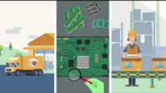
INVENTORY
Notes:
As an accounting term, inventory refers to all stock in the various production stages and is a current asset. By keeping stock, both retailers and manufacturers can continue to sell or build items. Inventory is a major asset for most companies. However, while inventory is an asset on the balance sheet, too much inventory can become a practical liability.

Slide 4
About Inventory Management
Inventory management is a step in the supply chain where inventory and stock quantities are tracked in and out of your warehouse.
The goal of inventory management systems is to know where your inventory is at any given time and how much of it you have in order to manage inventory levels correctly.
Why Is Inventory Management Important
Inventory management is the fundamental building block to longevity. When your inventory is properly organized, the rest of your supply-chain management will fall into place. Without it, you risk a litany of mistakes like mis-shipments, out of stocks, overstocks, mis-picks, and so on.

Slide 5
Inventory Management Stages
There are five main stages to follow:
Purchasing: This can mean buying raw materials to turn into products, or buying products to sell on with no assembly required
Production: Making your finished product from its constituent parts. Not every company will get involved in manufacturing — wholesalers, for instance, might skip this step entirely
Holding stock: Storing your raw materials before they’re manufactured (if required), and your finished goods before they’re sold
Sales: Getting your stock into customers’ hands, and taking payment
Reporting: Businesses need to know how much it is selling, and how much money it makes on each sale

Slide 6
MARUTI SUZUKI
Maruti Udyog Limited (MUL) : established in 24- February 1981,
though the actual production commenced in 1983 with the
Maruti 800, based on Suzuki alto kei.
Maruti Udyog Limited was renamed as Maruti Suzuki India
Limited. (17 Sept. 2007,)
Notes:
Based in New Delhi.
It was founded in 1981 and owned by the Government of India until 2003,
When it was sold to Suzuki Motor Corporation.
As of September 2021 Maruti Suzuki has a market share of 49 percent in the Indian passenger car market.
Key People: R. C Bhargava (Chairman)
Kenichi Ayukawa (Managing Director & CEO)
Products: Automobiles, Commercial Vehicles, Automotive Parts.
In October 2 1982 the company signed the license and joint venture agreement with Suzuki Motor Corporation Japan

Slide 7
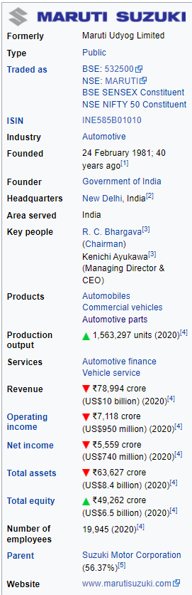
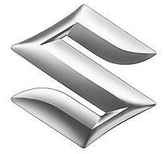
Notes:
Next Is a Video for Inventory Management Techniques by the description of CIO, of Maruti, Shri Rajesh Uppal

Slide 8


Slide 9
JIT (Just-In-Time) Inventory Management Techniques
Just-in-time (JIT) inventory management is a technique that arranges raw material orders from suppliers in direct connection with production schedules.
JIT is a great way to reduce inventory costs. Companies receive inventory on an as-needed basis instead of ordering too much and risking dead stock. Dead stock is inventory that was never sold or used by customers before being removed from sale status.
JIT and E-Nagare inventory management
Notes:
JIT and E-Nagare inventory management systems, started in 2003, have brought the inventory levels down to less than a day.
In 2010-11, the company started encouraging its suppliers to supply material during the night shift, which helped in reducing pollution and traffic congestion in and around its plant in Gurgaon city.
A “milk run system” was also introduced in 2010-11 for thirty suppliers based in Faridabad. The logistics for these companies is managed by one logistic supplier. This initiative helped in bringing down the number of trips per day to MSIL by 30 per cent from these suppliers and improvement in the truck fill rate by over 25 per cent.
E-Nagare- At the Rs 30,000-crore Maruti Suzuki, India's largest carmaker, E. Nagare or 'electronic flow' is a religion. Simply put, this electronic flow is actually the sequence of production plans from the vendor to Maruti's shopfloor, which now sits at a two hour cycle from 30 days in the past.
Maruti receives multiple supplies in a day within a slot of two hours based on the information given out to its vendors the previous night
The e-Nagare system enabled vendors with the correct schedule visibility. Automotive assembly lines, like that of Maruti, are designed to build multiple models on one line.

Slide 10
JUST-IN-TIME BY MARUTI
JIT in Maruti Udyog Limited:
Maruti is going about the task in the typical Japanese methodical fashion of Plan, Do, Check and Action.
The eight typical wastages at each operational point (over-production, man movement, material movement, idle time of operator, work-in-process, machine availability, waiting time and needless processing) have been measured by observation and even videography.
Some Initiatives:
Use Bar Code, Reduction of Vendor costs, Delivery Instructions System, Vendor Management
Notes:
Maruti is now working with an inventory of four hours maximum for local items and six days average for imported materials.
The inventory to sales turnover ratio, on the scale of 100 in 2014-2015, is now down to 41. Maruti has also started working with its vendors to reduce their cost of production so that its own cost of bought outs can be reduced. It has also launched a quality enhancement scheme recently, called as the Quality Gate system.
Ordering costs are the expenses incurred to create and process an order to a supplier
carrying cost of inventory or holding cost refers to the total. Cost of holding inventory. .
Steps to reduce these costs: Vendor Management• Localization

Slide 11

Benefits of Just-in-Time Manufacturing:
Inventory levels are drastically reduced
Product quality is improved
Cost of scrap is reduced.
Promotes teamwork among workers.
Manufacturing operations are streamlined and problem free.

Slide 12
Financial Ratios
Current Ratio
The current ratio is a liquidity ratio that measures whether a firm has enough resources to meet its short-term obligations.
Quick Ratio
the acid-test ratio is a type of liquidity ratio, which measures the ability of a company to use its near cash or quick assets to extinguish or retire its current liabilities immediately.
Inventory Turnover Ratio
Inventory turnover is the rate at which a company replaces inventory in a given period due to sales.
Notes:
Working Capital: - Working capital turnover measures the relationship between the funds used to finance a company's operations and the revenues a company generates to continue operations and turn a profit.
As we show in the current ration the companies Liquidity are Increase
Quick ratio is initially starts decrease but after the march report 2020 it improve(More Assets are converted into cash, If the company Necessary)
Inventory Turnover Ratio shows that its holding its Inventory Longer then Previously measured time period.

Slide 13
Cont.…
Receivables Turnover Ratio
The receivables turnover ratio is an accounting measure used to quantify a company's effectiveness in collecting its accounts receivable, or the money owed by customers or clients.
Working Capital Turnover Ratio
Working capital turnover is a ratio that measures how efficiently a company is using its working capital to support sales and growth. Also known as net sales to working capital
Return on Capital Employed
Return on capital employed (ROCE) is a financial ratio that can be used to assess a company's profitability and capital efficiency. In other words, this ratio can help to understand how well a company is generating profits from its capital as it is put to use.
Notes:
Receivables turnover Ratio : As of now from 2018 to 2020 the AR Ratio is Decreases that’s basically the cause of Company’s Credit Policy and Increasing Problems with collecting Receivables on time.
Working Capital Turnover Ratio: company has not sufficient short term funds for fulfilling the sales done for that period.
Yes, the company is making good Use of Technology, i.e. Delivery instruction system, Bar-Code and E-Nagare.

Slide 14

